Slide 1

Lessons from the classroom
Using and adapting DSECOP modules for undergraduate classes

Slide 2
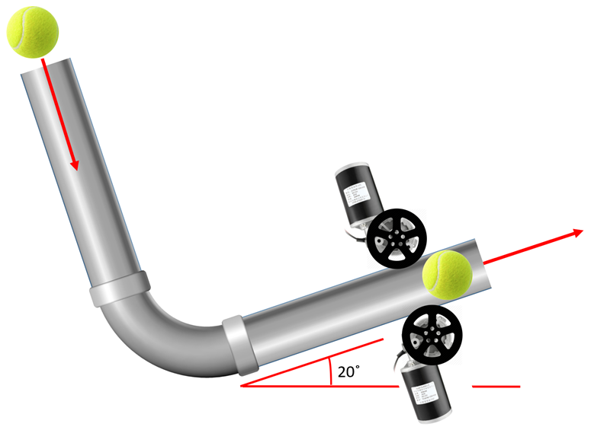
Projectile Motion, Drag, and Data Science
The class: PHY 117 at Smith College (Introductory Physics I: Newtonian Mechanics)
The students:
engineering, pre-health, and prospective physics majors
80% first year students
The curriculum
Calculus-based Newtonian Mechanics
Week 3: projectile motion with the constant acceleration kinematics equations
The ”lab”
Shooting tennis balls and predicting where they will land
Discovery: uh oh… drag is significant!
Image source: Engineering Stack Exchange

Slide 3
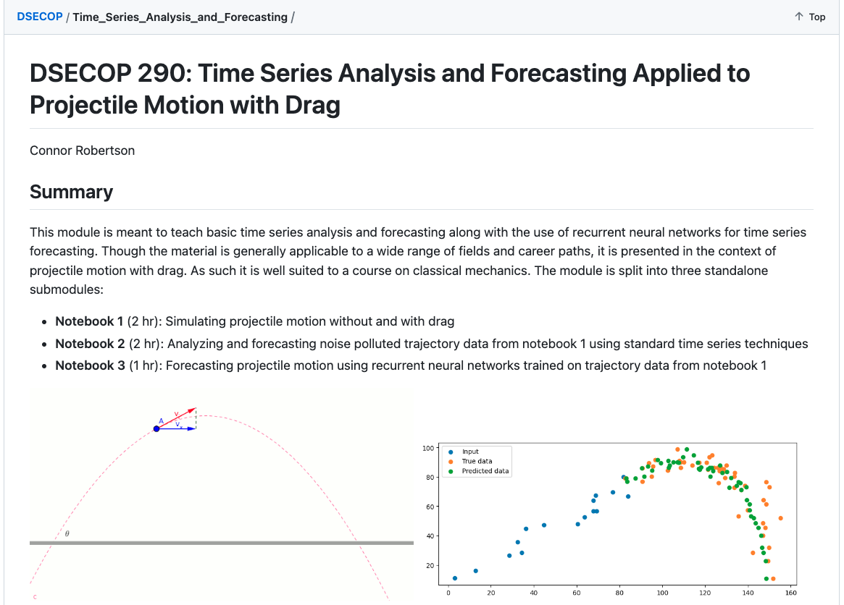
Projectile Motion, Drag, and Data Science

Slide 4
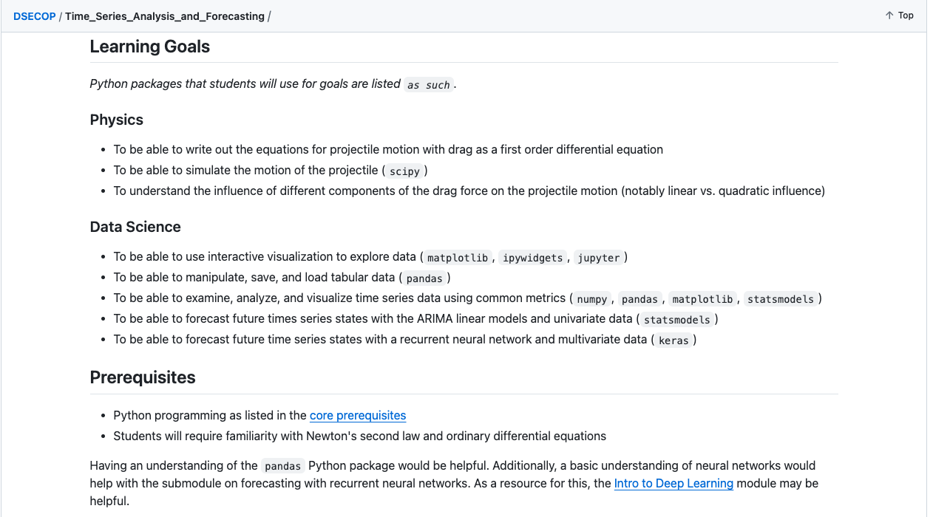


Projectile Motion, Drag, and Data Science: Challenges
too advanced
beyond the scope of the class
varying levels of background

Slide 5
Projectile Motion, Drag, and Data Science
My goals
Use the basic format and ideas of this notebook
Modify the math to be appropriate for intro physics
Make more connections to the basics of projectile motion
Lean on visualizing data rather than predicting values
This class was the first time many students had seen anything in Python, so I wanted to make it as accessible as possible

Slide 6
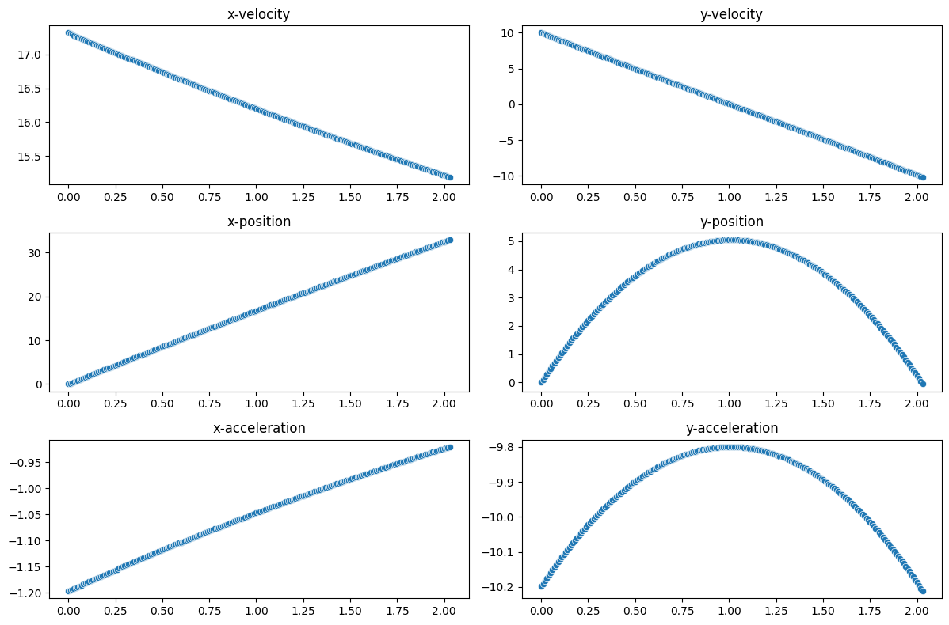
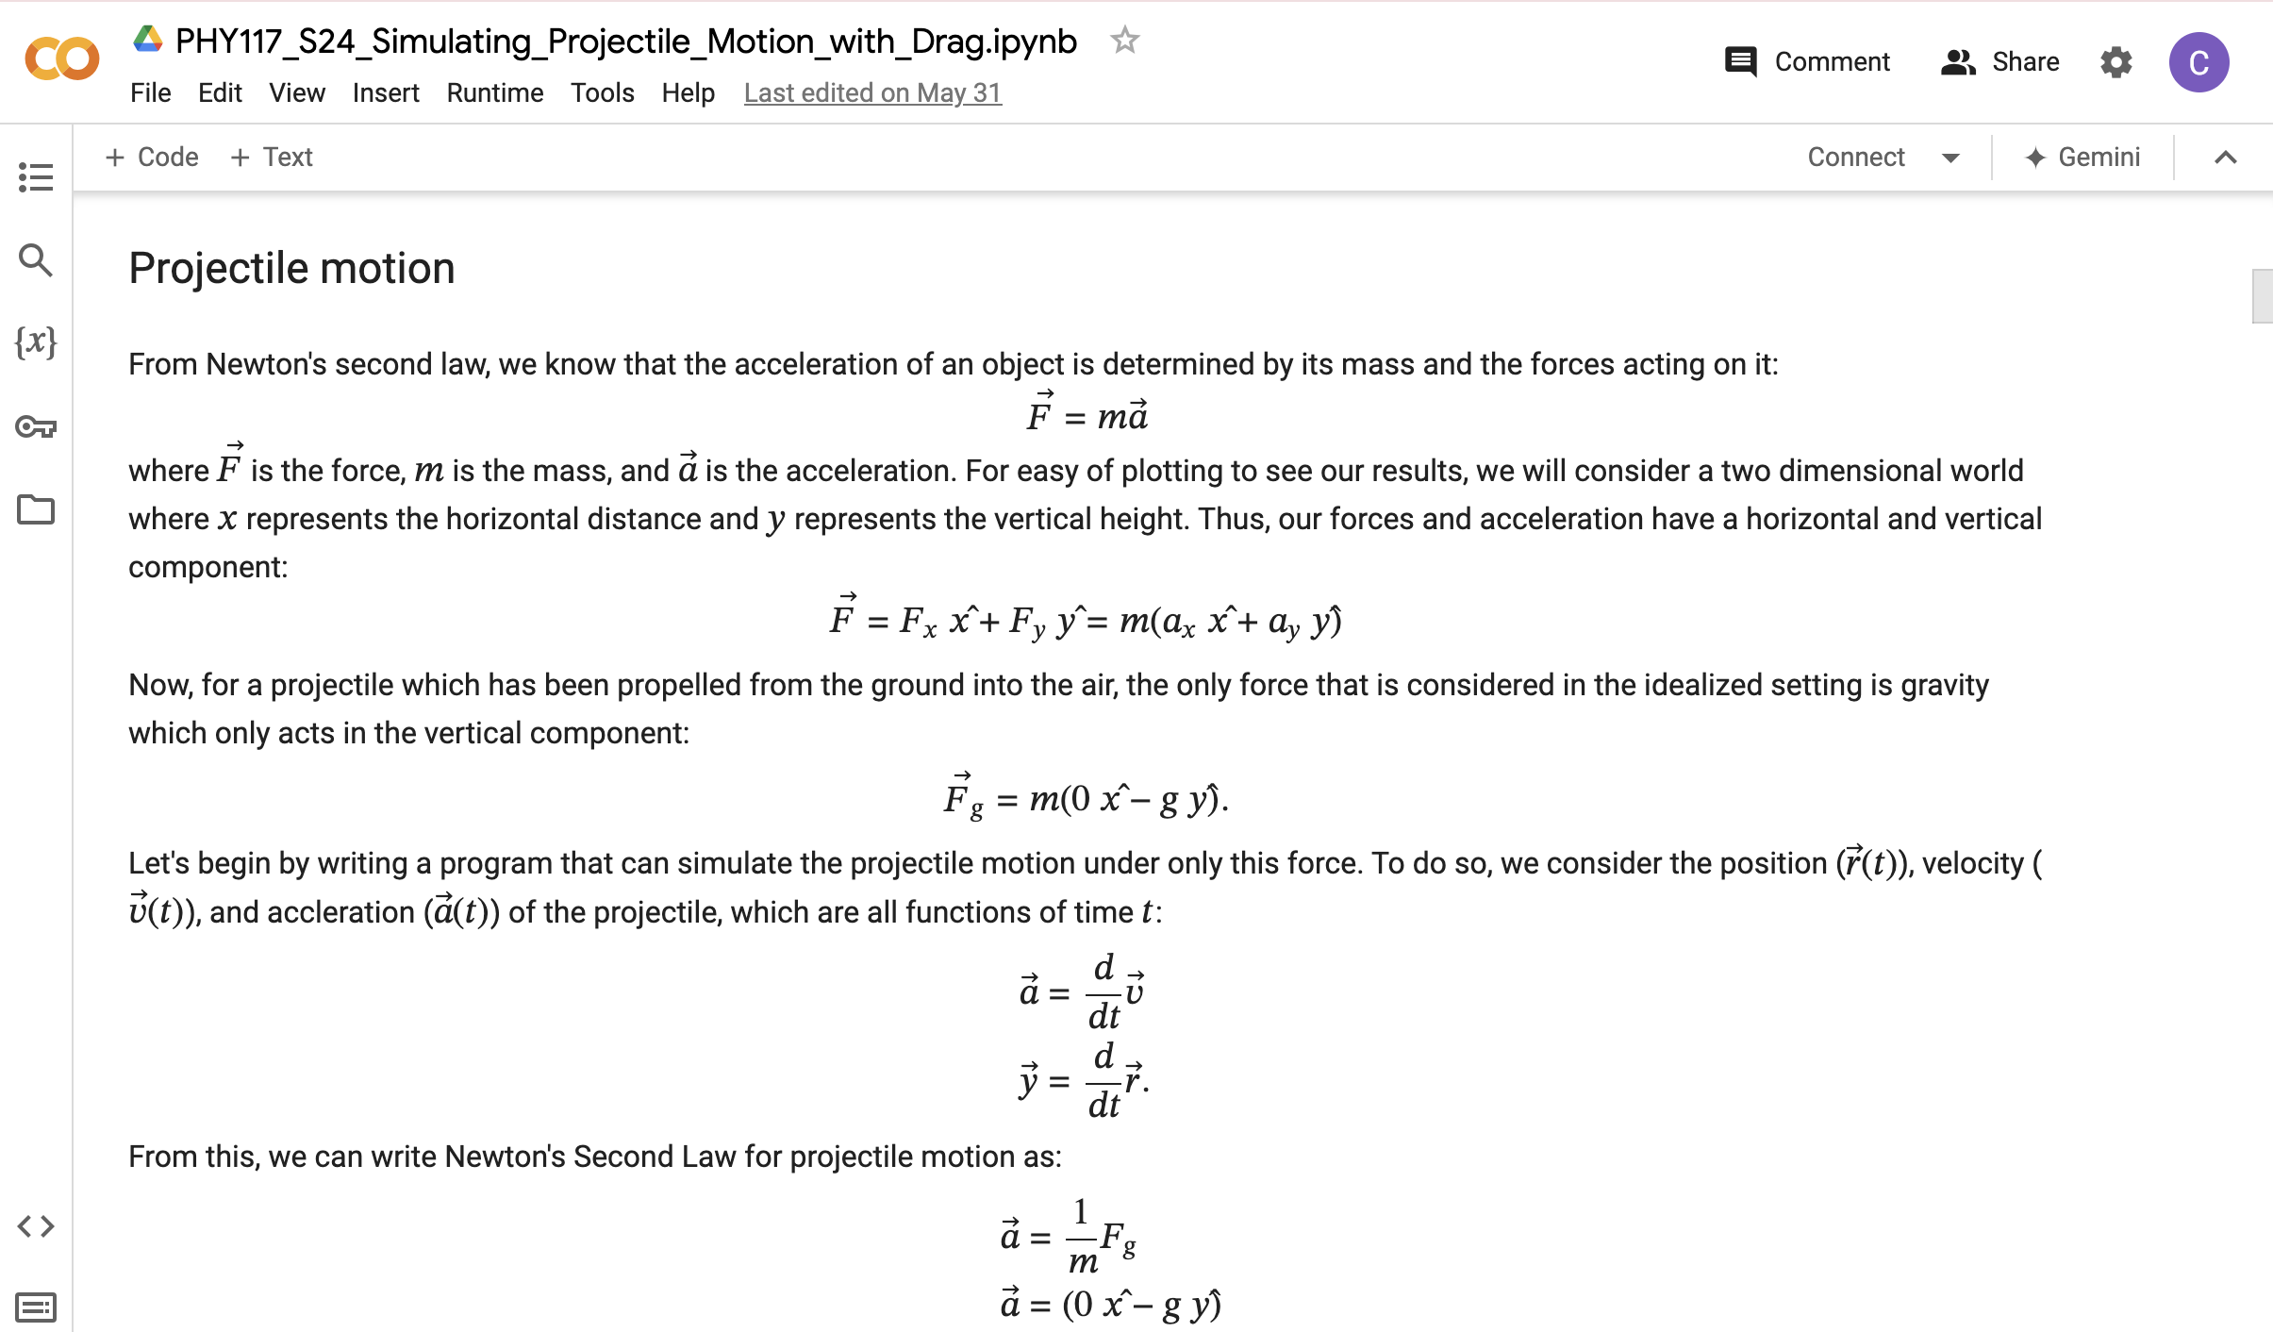
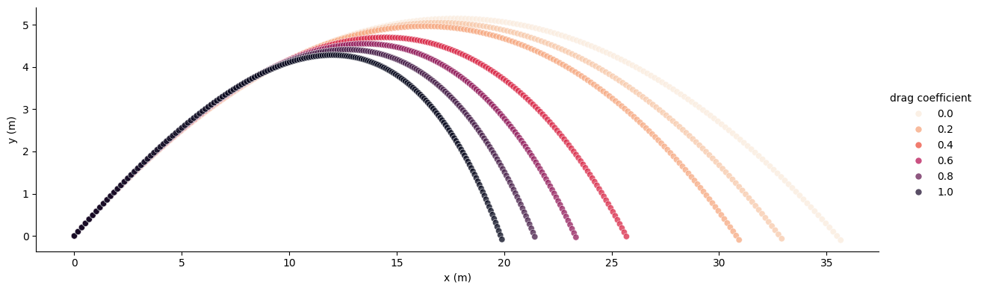
Modified notebook

Slide 7
Results
Some students got really invested in the process
Others just wanted to get the answer and go
Learning goal achievement:
Everyone at least ran the notebook and changed a few lines of code
Brief discussion at the end to solidify understanding of the complexities of real-life physics
Don’t be afraid to modify these modules to suit the needs of your class

Slide 8
A brief summary of other experiences
Multiple modules provided excellent practice material for a research student
Senior computer science major, physics minor
Started with Learning the Schrodinger Equation
Supplemented with some Quantum Mechanics readings
Next: Connecting Monte Carlo to Modern AI
Supplemented with some Statistical Mechanics readings
Advanced, independent student – well-prepared for this work
YMMV when applying to non-physics courses
Intro to Data Science Libraries was an excellent introduction for my “Programming for Data Science in Python course”
They all learned how to use pandas, seaborn, and matplotlib
But the students hated the physics examples (almost none were science majors)
Know your audience!

Slide 9
Make these modules your own
Don’t be afraid to modify them
Find what works and keep it
Exposure to data science tools can look many different ways
Know your audience and provide ways for students to give feedback on the process

Slide 10
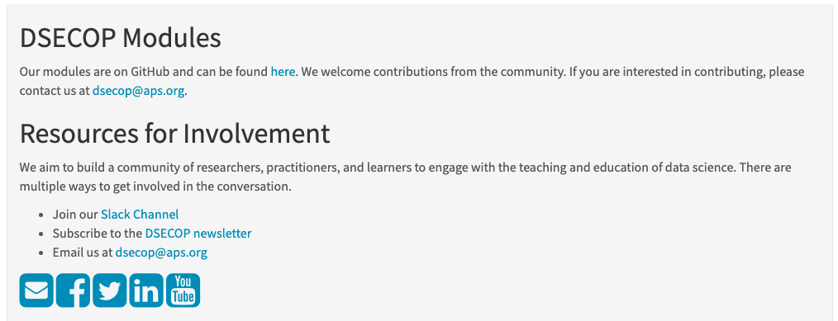



Continuing the conversation
Email me: cberger3@bates.edu
Join the topical group on data sciences
Access these resources at www.dsecop.org

